Slide 1



PowerShell
Created for endpoint management*
* Don’t fact check that, I’m not really sure, but it sounds good for a subtitle

Slide 2
Please feel free to ask questions
I probably won’t be monitoring CHAT, so if someone would like to own chat monitoring duties, that’d be great.
Feel free to raise your hand / or come off mute and ask.
This will be less of a formal presentation, and more of a “Hey, this is the stuff I’ve been working on lately” conversation

Slide 3
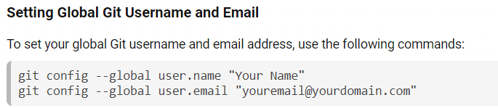
PowerShell Starters
My Setup
Install PowerShell 7
Install VS Code
Install GIT for Windows & setup username & email (Launch Terminal and ☝️)
Setup VSCode to leverage GitHub for my two main repos, each using their own workspaces (garytown, osdcloud)
GitHub Copilot… totally worth it!

Slide 4
PowerShell Starters
DEMO Setup
Other helpful Tools: WMIExplorer!

Slide 5
ISE, it’s still useful and it’s always there for you
It’s just there, sure it hasn’t changed much over the years, but that’s not always bad.
Useful on test machines when you just need to test some small scripts
When I need to run code as ADMIN, ex: Building WinPE Boot WIMs
It’s available during OSD (in full os), allowing you to test your scripts as system

Slide 6
OEMs and their PowerShell offerings
Dell has very little official PowerShell scripts or tools
HP has an active team working on ‘HPCMSL’
Lenovo has recently released their first versions of a module
Community has done a lot to fill gaps… Driver Automation Tool as an example.

Slide 7



Dell
Dell (Not much change in past 2 years)
Dell PS Provider for BIOS Management (should be obsolete with modern hardware)
Dell’s Endpoint Management Script Library on GitHub dell/Endpoint-Management-Script-Library: Client Management Script Library setup for Intune.
Sven’s Tools - Intune scripts for some of the tools svenriebedell/Dell-Tools-Intune-Install: Providing scripts for deploying Dell Tools with Intune
Mesut’s Update List: mkaptano/tools: Listing of popular Dell Tools
People to know on X
Sven Riebe (@SvenRiebe) / X
Mathieu Ait Azzouzene (@MatAitAzzouzene) / X
Mesut Kaptanoğlu (@mkaptano) / X

Slide 8




HP
HP CMSL is under active development and frequent new releases… and some features are handy on any hardware. (Toast Notifications)
Insider Info: Future tools plan to have additional PS / Command line Support
Manage BIOS Settings, Monitors, BIOS Updates, find drivers, driver packs, model info, basically it’s HP’s database available via PowerShell
I’ve used this to automate a TON of things for HP in OSD and Intune. (which will eventually become obsolete by HP’s future tooling)
People to know on X
Mark Godfrey (@Geodesicz) / X
dan felman (@dan_felman) / X
Warren Byle (@WarrenByle) / X
Nathan Kofahl (@nkofahl) / X
Val (@txvalp) / X

Slide 9


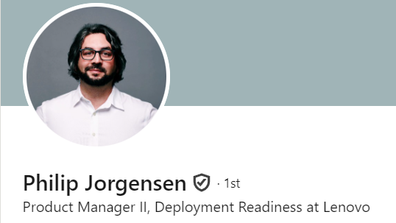
Lenovo
Have started investing in a module, first and second releases in last 6 months
They don’t show up yet under Lenovo Tools for Admins, can be hard to find
Lenovo Client Scripting Module - Lenovo CDRT Docs Site
Still pretty basic, but improving rapidly, good at taking feedback.
Please to know (often at MMS)
Philip Jorgensen (linkedin)
Joe Parker (@joe_lenovo) / X

Slide 10
Community
LENOVO: LSUClient is an all-PowerShell alternative to “Lenovo System Update” - Introduction | LSUClient Documentation
HP – OSD Module (OSDCloud) / gary’s GitHub
OSD/Public/OSDCloudTS/Invoke-HPIA.ps1
hp.garytown.com
Dell – OSD Module (OSDCloud) / gary’s GitHub
OSD/Public/OSDCloudTS/Install-DellApps.ps1
dell.garytown.com
Lenovo – OSD Module (OSDCloud)
OSD/Public/OSDCloudTS/Install-LenovoApps.ps1
lenovo.garytown.com

Slide 11
Dell DEMO

Slide 12
HP DEMO

Slide 13
Lenovo DEMO

Slide 14
Feedback / QA Time
Requests for PowerShell functions?
Thoughts on what you saw today?
What are your current pain points with the OEMs and their Tools?

